Slide 1
English isiXhosa Mobile Vocabulary Learner
Zandre Botha

Slide 2


The Molo app

Slide 3


Slide 4
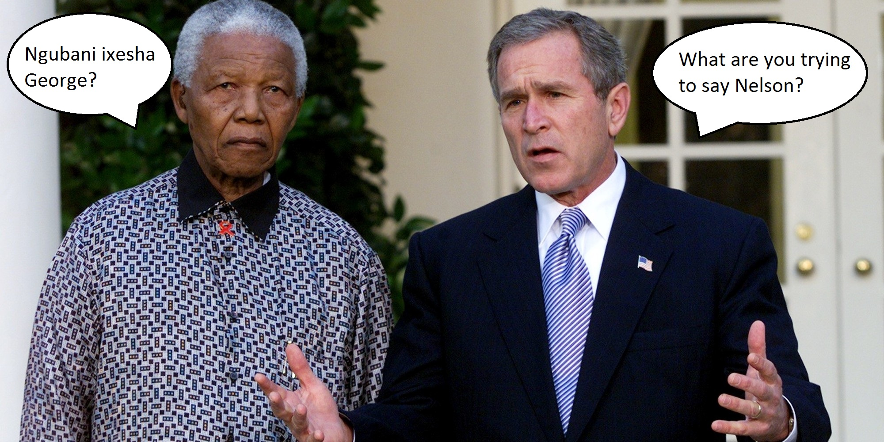
Confused?

Slide 5
Learn English or isiXhosa in a heartbeat!
Super cool features such as
New Lessons with audio examples
Voice pronunciation exercises
Writing exercises
Multi-choice exercises
Matching exercises

Slide 6
The Molo app

Slide 7
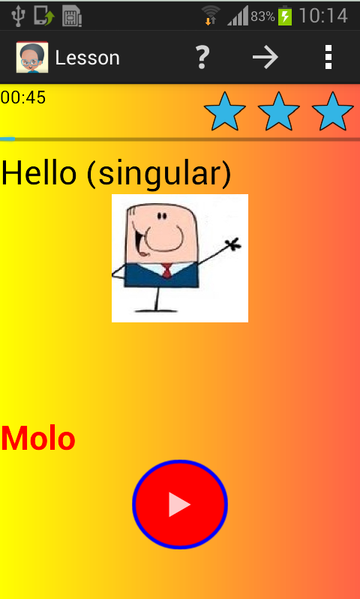
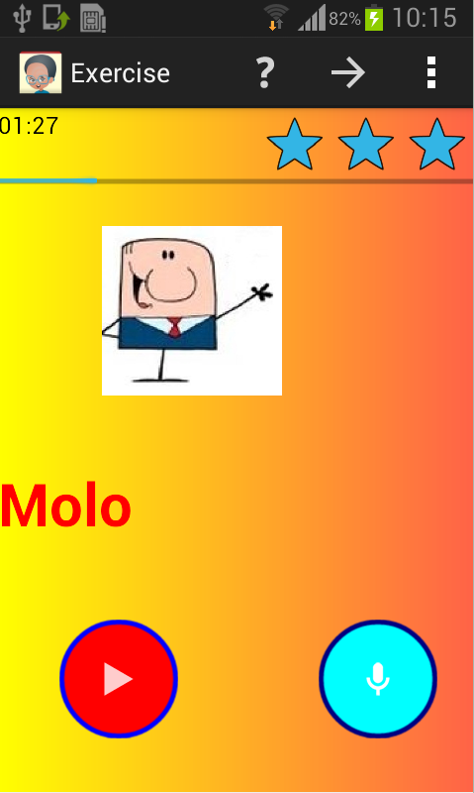

Lessons & Voice exercises with audio examples

Slide 9
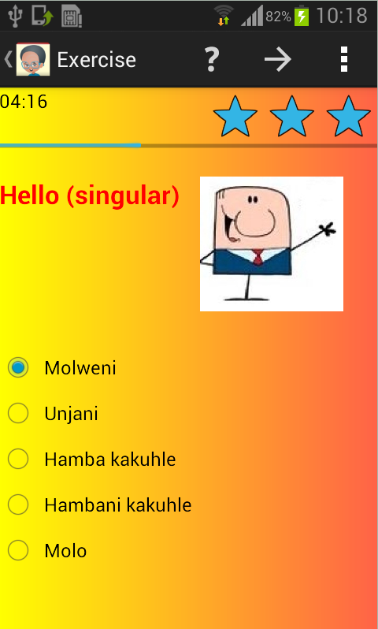
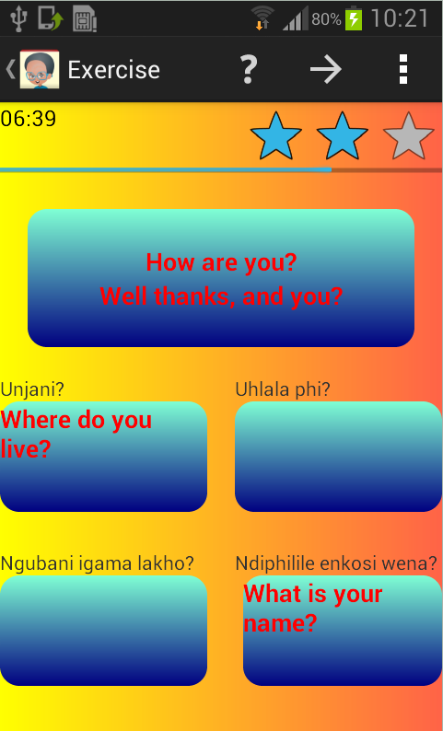
Multi-choice and Matching exercises

Slide 10
Confused?

Slide 11
Learn English or isiXhosa in a heartbeat!
Super cool features such as
New Lessons with audio examples
Voice pronunciation exercises
Writing exercises
Multi-choice exercises
Matching exercises

Slide 12
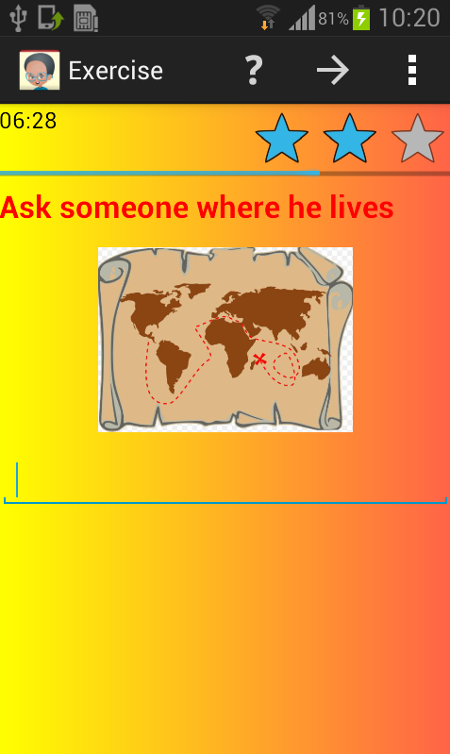
Writing Exercises

Slide 13
The Molo app

Slide 14
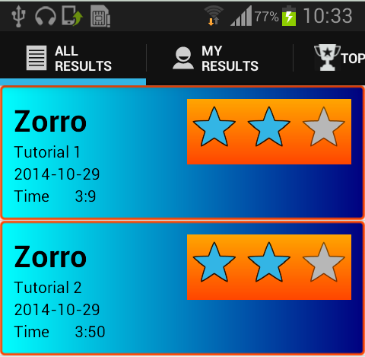
Track your progress and compete with friends with this super awesome scoreboard!

